Slide 1




















The Evolution of Cooperation

Slide 2

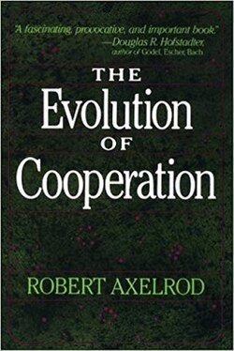
Robert Axelrod and William D. Hamilton (1981)

Slide 3





Cooperation can evolve
Cooperation can evolve – if it’s rewarded over time
Using the Game theory model : Prisoner’s Dilemma
Tit for Tat : start by cooperating, then copy partner’s last move

Slide 4







Impact on animal behaviour
Before this paper, scientists believed that true cooperation among animals was rare
Altruistic behaviour: one animal helps another at a cost to itself
Reciprocal altruism: Cooperation naturally emerge in repeated interactions

Slide 5
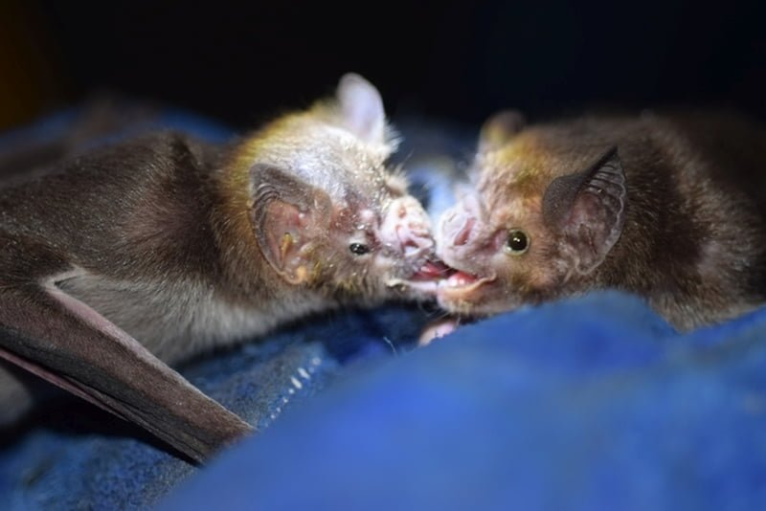
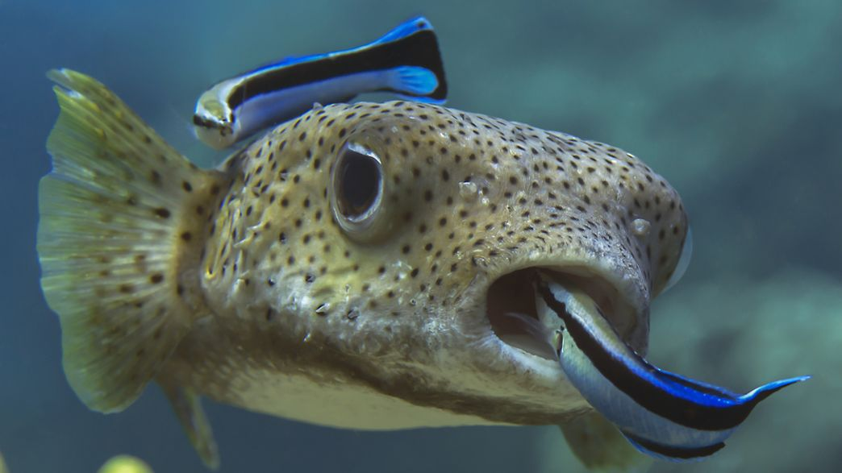
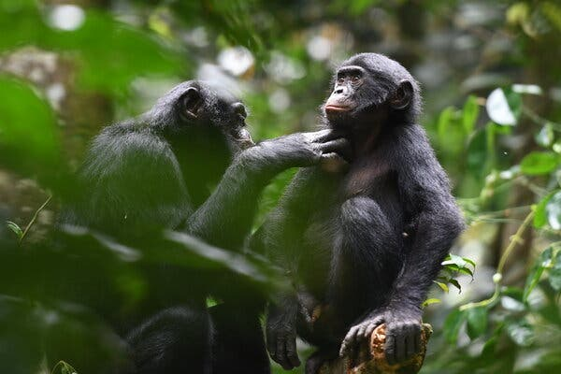
Vampire bats sharing food
Fish cleaning parasites off other fish
Primates forming alliance

Slide 6
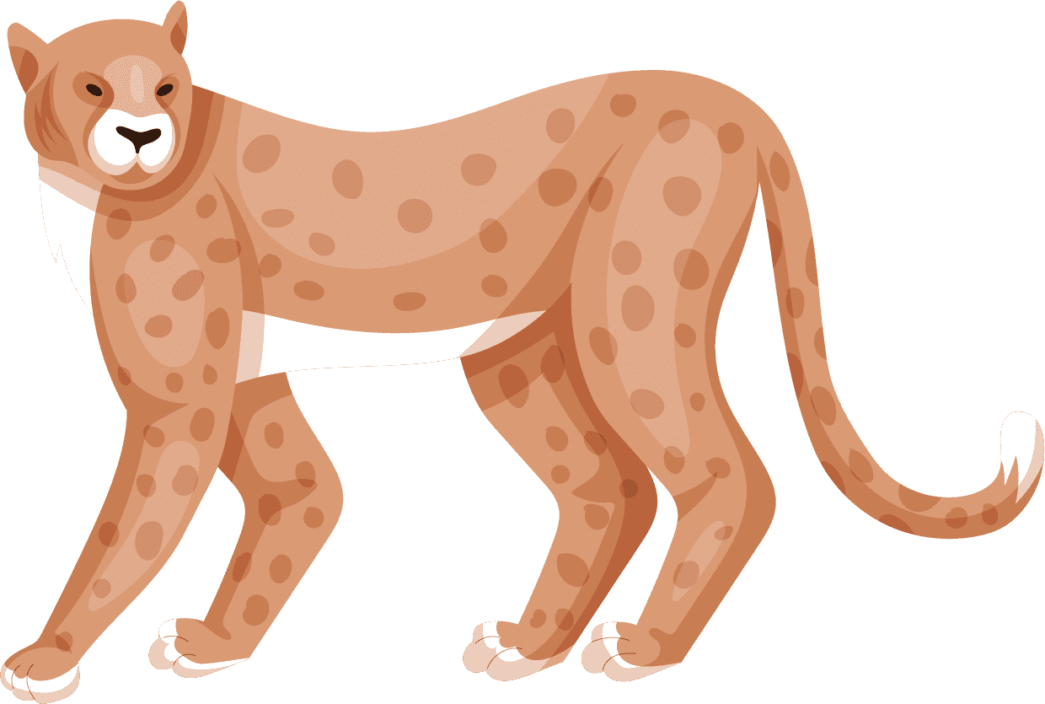
Authors & Related Work
Robert Axelrod
Political Scientist
Continued his work in “The Evolution of Cooperation (1984)”
Expanding to human societies, international politics, and computer science
William D. Hamilton
Biologist
Famous for theory of kin selection
Used this paper to extend evolutionary theory to non-kin cooperation

Slide 7


—Axelrod and Hamilton
What makes cooperation possible in a world driven by self interest?
It’s not just biology – it’s interaction, memory and strategy

Slide 8








Thank you

